Slide 1
Control Structures

Slide 2
Control Structures
If statement – Single Branching.
If else Statement - Single Branching.
Switch Statement – Multiple branching.

Slide 3
If statement
If statement: Syntax
if( condition )
{
// Code here
}

Slide 4
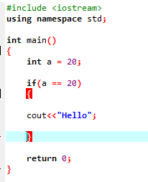
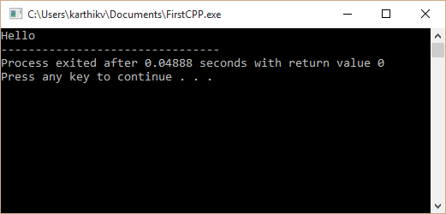
Example

Slide 5
If statement
If else statement: Syntax
if( condition )
{
// Code here
}
else
{
// Code here
}

Slide 6
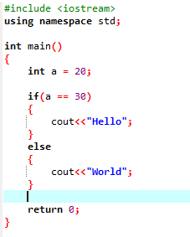
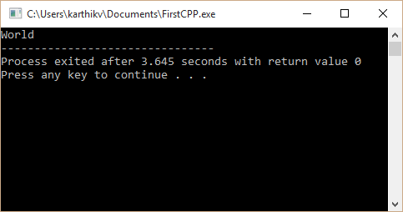
Example

Slide 7
If statement
Switch statement: Syntax
switch (choice)
{
case :
//code
break;
case :
//code
break;
}

Slide 8
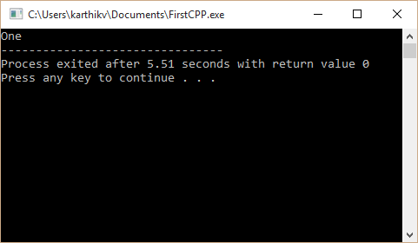
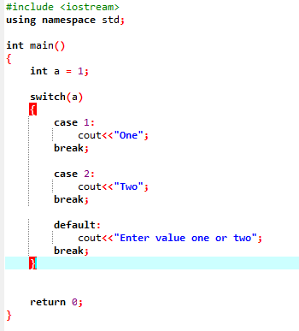
Example

